Slide 1
Time Series Deep Learning
Matt Dancho
Founder & CEO, Business Science
business-science.io
April 19, 2018

Slide 2
About Business Science
We are applications people that build tools to solve tough problems
We serve the data science community
We empower organizations
Expert coaching, training, & consultation
R Package Development, Shiny Web Apps, R Programming
NEW!! Business Science University (BSU)

Slide 3





Open Source
NEW!!
Anomaly Detection
Most Popular
Financial Data
Stock/Portfolio
Analysis
Time-Aware
tibbles
(dplyr)
Helps Do Time-Based
Forecasting
w/ forecast
Time Series ML

Slide 4
We Love Time Series

Slide 5
Objectives
Importance of Time Series
Challenges & Opportunities
Deep Learning for Time Series

Slide 6
Importance of
Time Series

Slide 7
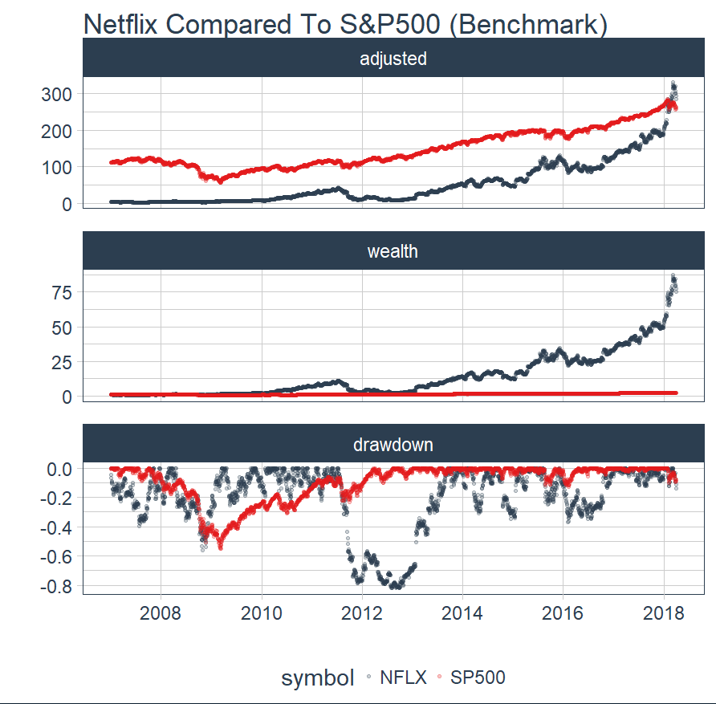
Importance of Time Series
Netflix vs S&P500
Woo Hoo!!!
Gain vs Pain
Ouch!!!

Slide 8
Financial Data
Prediction Is Critical
Netflix Compared
To S&P500
Woo Hoo!!!
Gain vs Pain
Ouch!!!

Slide 9
New Challenges

Slide 10
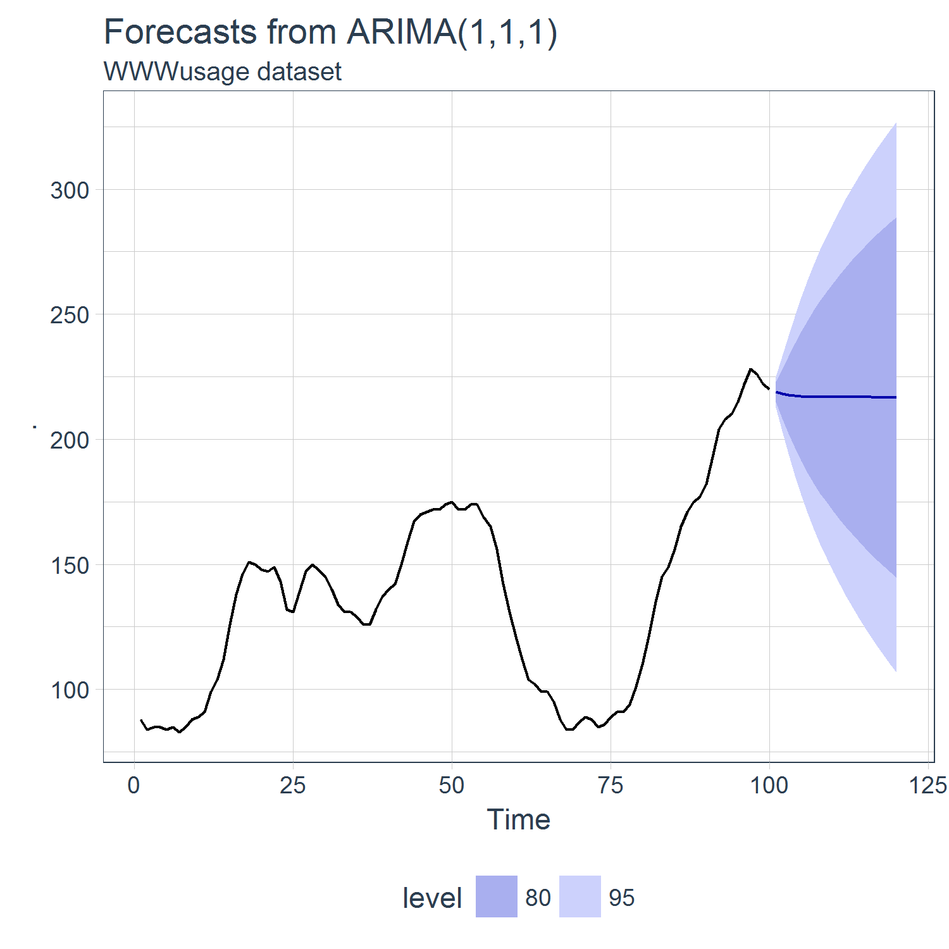
Data Is Changing
How Data Used to Be:
Short Time Series
Viewed As Univariate
Wide Forecast Margins

Slide 11
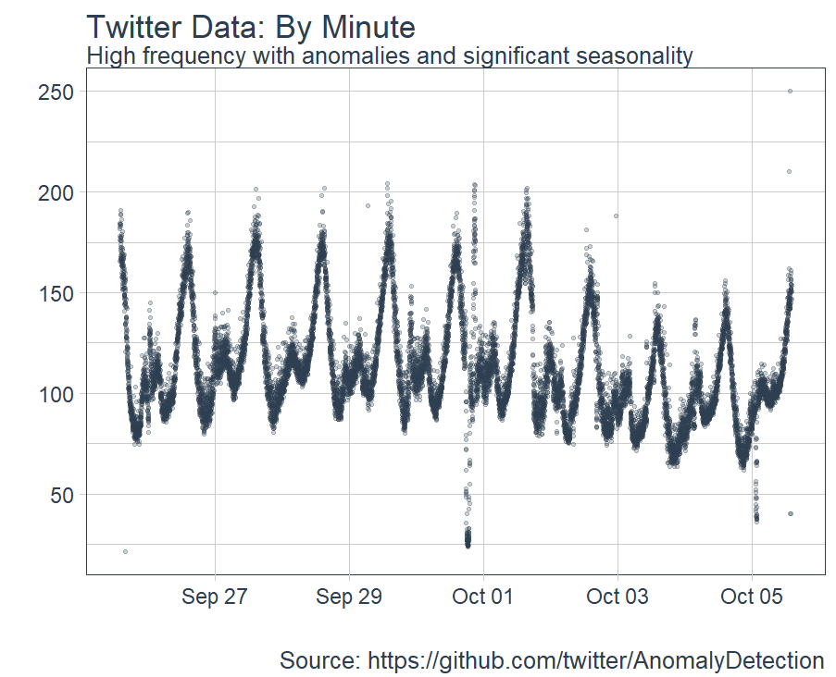
Today’s Data Is Different
High Frequencies
Time-Based Pattern
Multivariate Systems
Sparse Data
Event Driven
Anomalies

Slide 12
New Opportunities For
Time Series Prediction

Slide 13
New Techniques Available
Machine Learning:
Time Series Signature Pattern Recognition
Deep Learning:
Keras Stateful LSTMs
Our Focus Today

Slide 14
Deep Learning with
Keras Stateful LSTM

Slide 15
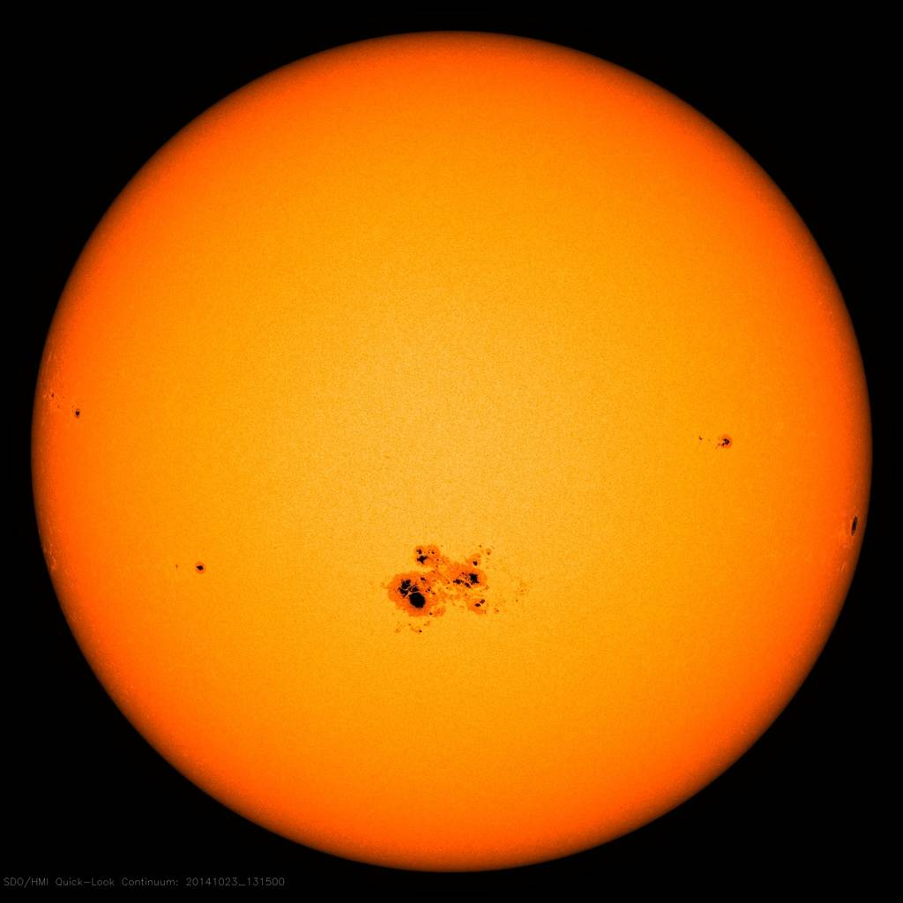
Sunspots Data
Solar Phenomenon
Not “Business” or “Finance” Data
Great Example of ML Tool-Application Fit
Source: https://www.nasa.gov/content/goddard/largest-sunspot-of-solar-cycle

Slide 16
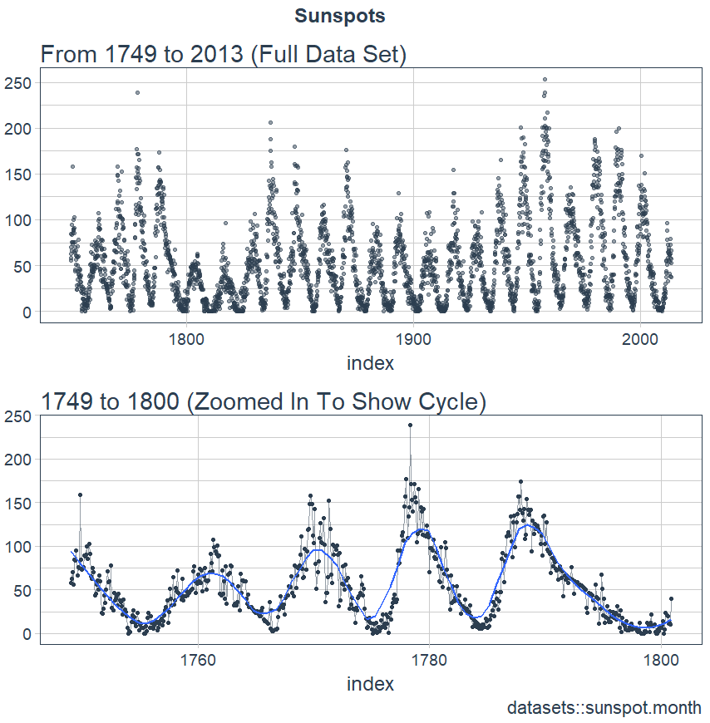
Sunspots Data
Looks easy to predict
Difficult
Cycle & amplitude changes

Slide 17
Objective:
Predict
Next 10 Years
Using Keras Stateful LSTM

Slide 18
Learning Path
Evaluate whether or not a time series may be a good candidate for an LSTM model by reviewing the Autocorrelation Function (ACF) graph
Perform Time Series Cross Validation using Backtesting with the rsample package rolling forecast origin resampling
Develop a Stateful LSTM Model with the keras package, which connects to the R TensorFlow backend.
What is an LSTM?
Is LSTM a good candidate?
Develop a Stateful LSTM Model using Keras
Time Series Cross Validation using Backtesting

Slide 19
LSTM
Special Type of Recurrent Neural Network (RNN)
Long-Short Term Memory
Models sequence data
“Understanding LSTM Networks” by Christopher Olah
Source: http://colah.github.io/posts/2015-08-Understanding-LSTMs/

Slide 20
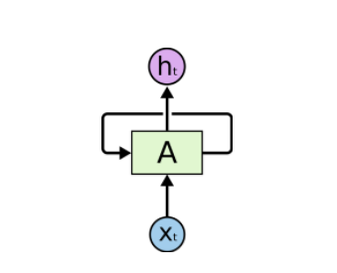
RNN
RNNs have loops
Enables persistence
Strengths:
Learning context based on what happened previously
Speech recognition, image classifying, etc
Source: http://colah.github.io/posts/2015-08-Understanding-LSTMs/

Slide 21
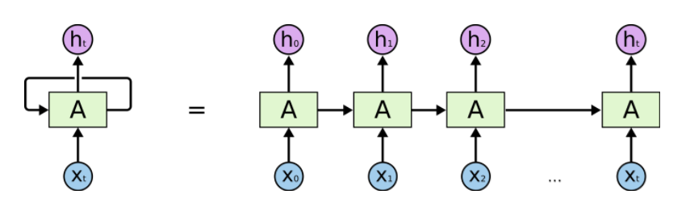
RNN
Unrolling The RNN Loop
Source: http://colah.github.io/posts/2015-08-Understanding-LSTMs/

Slide 22


LSTM
RNN
LSTM
Source: http://colah.github.io/posts/2015-08-Understanding-LSTMs/

Slide 23
LSTM
LSTM
Solves problem:
Long Term Dependencies
Source: http://colah.github.io/posts/2015-08-Understanding-LSTMs/

Slide 24
Is LSTM A
Good Candidate?

Slide 25
Is LSTM A Good Candidate?
LSTM’s take advantage of autocorrelation
Review ACF Plot

Slide 26
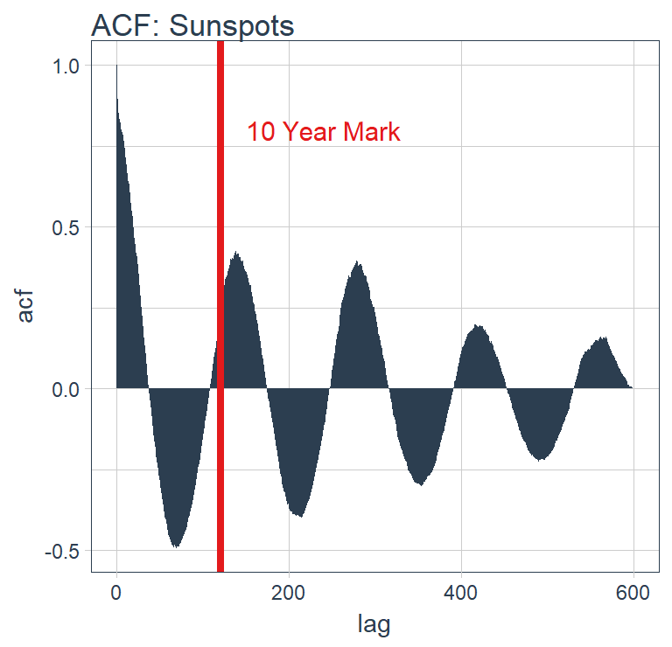
Is LSTM A Good Candidate?
Autocorrelation
Batch prediction
Lag at 120 months (10 years) to predict next 10 years!
Autocorrelation!!!

Slide 27
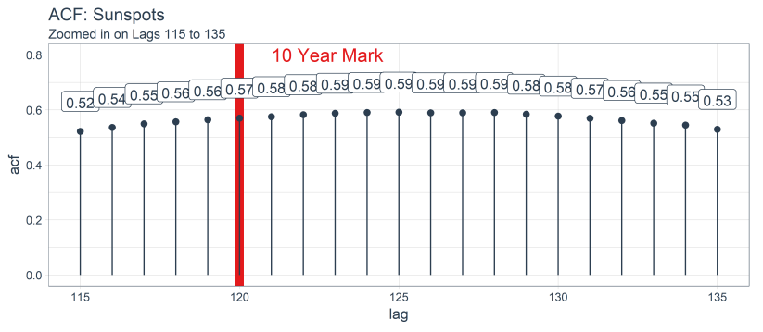
Is LSTM A Good Candidate?

Slide 28
Developing A
Stateful LSTM
With Keras

Slide 29
Keras Stateful LSTM Terminology
Batch Size:
The batch size is the number of training examples in one forward/backward pass of a RNN before a weight update
Time Steps:
A time step is the number of lags included in the training/testing set
Epochs:
The epochs are the total number of forward/backward pass iterations

Slide 30
Keras Stateful LSTM
Stateful: No reshuffling between batches
Time dependency is preserved
Higher accuracy than stateless

Slide 31
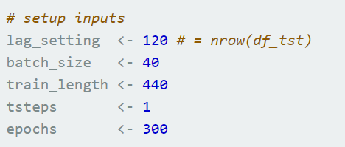
Keras Stateful LSTM
Keras Input Setup
Stacking Bricks

Slide 32

Modeling With Keras
Stacking Bricks

Slide 33
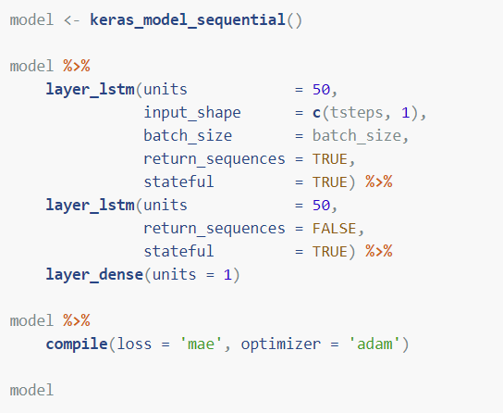
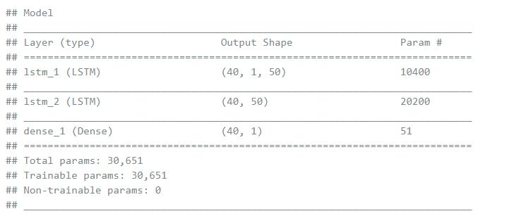
Keras Stateful LSTM
Stacking Bricks

Slide 34
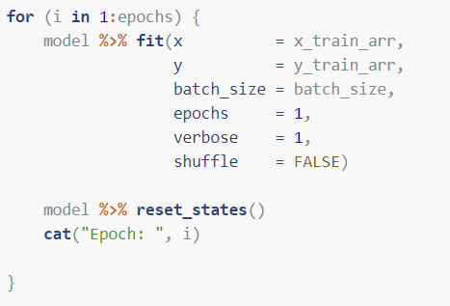
Keras Stateful LSTM
Fitting The Model
Stacking Bricks

Slide 35
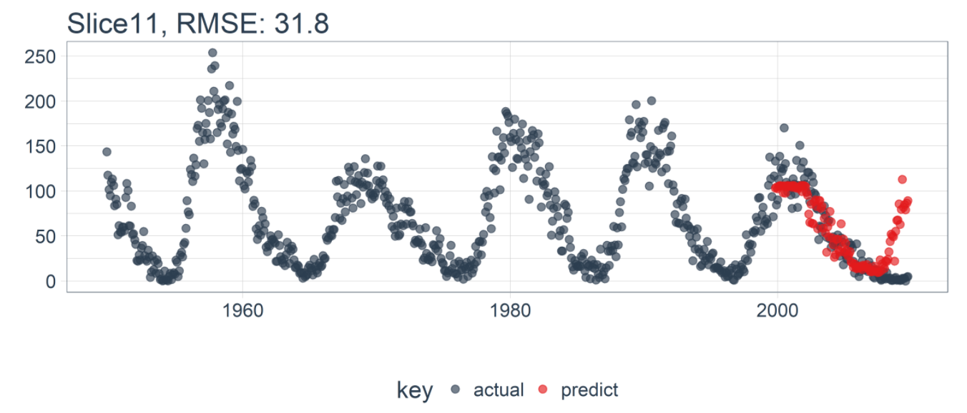
Keras Stateful LSTM
Stacking Bricks

Slide 36
Backtesting

Slide 37
Backtesting Strategy

Slide 38
Backtesting Strategy

Slide 39
Backtesting Strategy

Slide 40
Backtesting Strategy

Slide 41
Backtesting Strategy

Slide 42
Backtesting Strategy

Slide 43
Backtesting Strategy

Slide 44
Backtesting Strategy

Slide 45
Backtesting Strategy

Slide 46
Backtesting Strategy

Slide 47
Backtesting Strategy

Slide 48
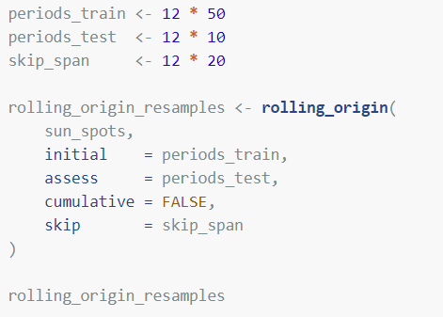
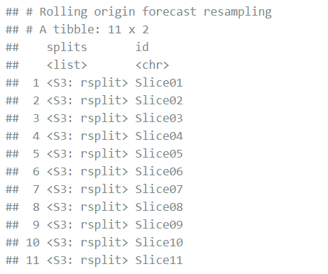
Backtesting Strategy
rsample::rolling_origin()

Slide 49
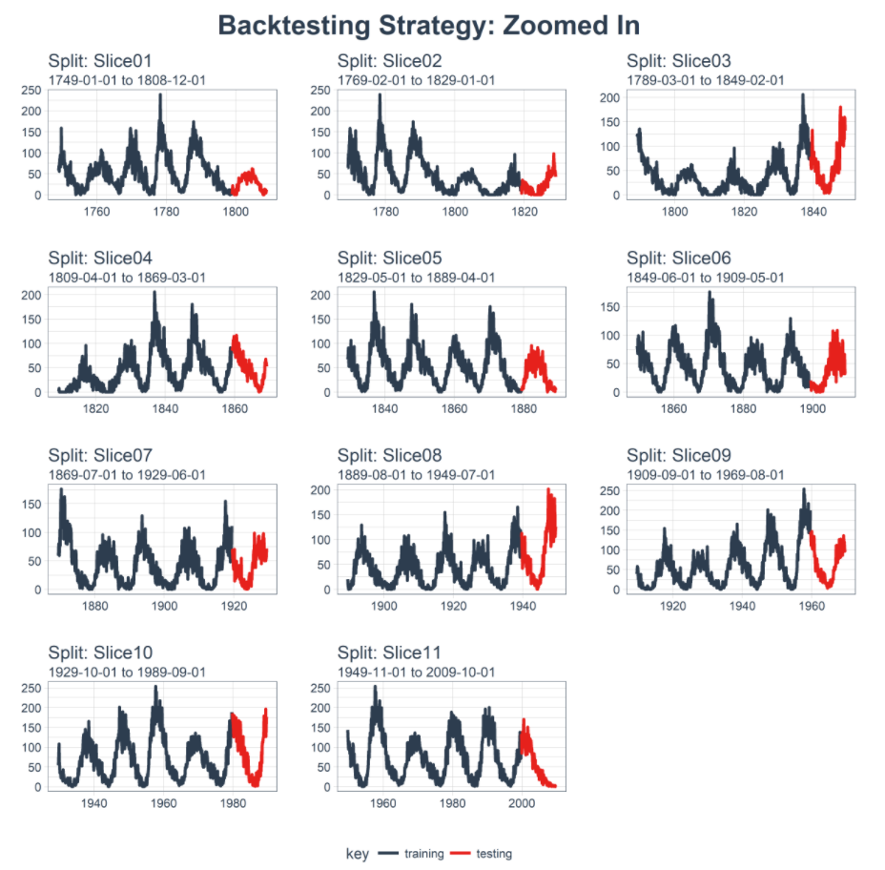
Backtesting Strategy
Sampling plan
1 Time Series →
11 Time Series Samples →
Training Set
Testing Set

Slide 50
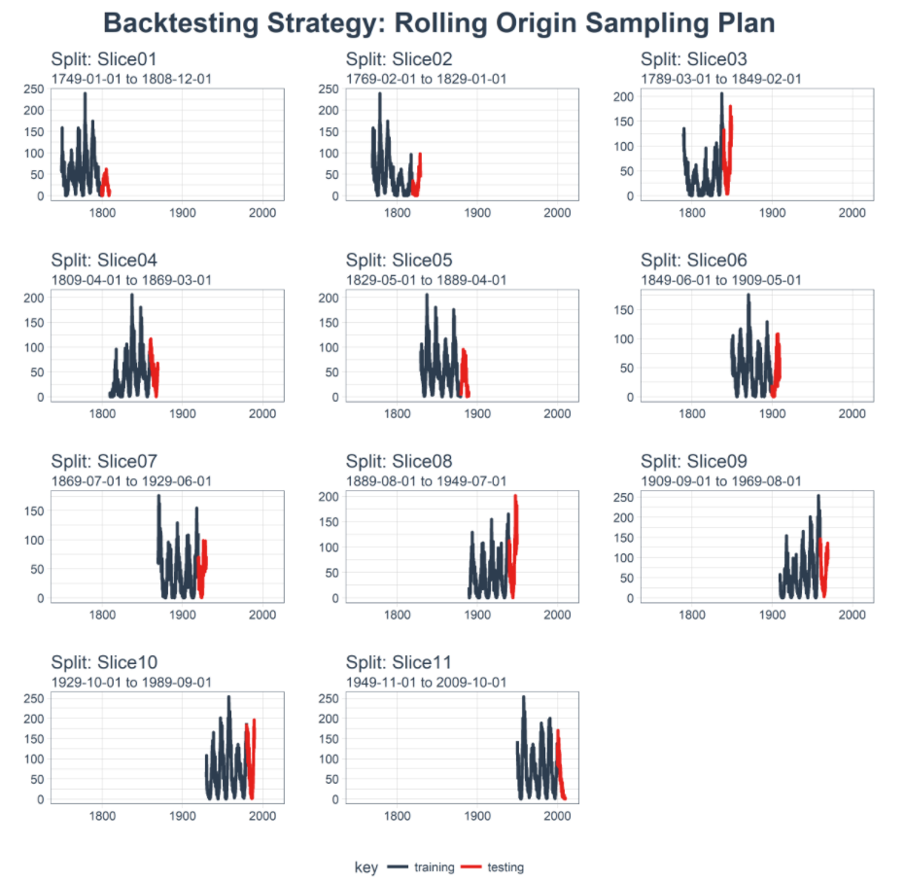
Backtesting Strategy
Zoomed Out
Train: 50 years
Test: 10 years
Gap: 20 years
Training Set
Testing Set

Slide 51
Results

Slide 52
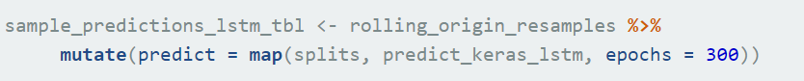
Keras LSTM Results
map(): custom keras prediction function

Slide 53
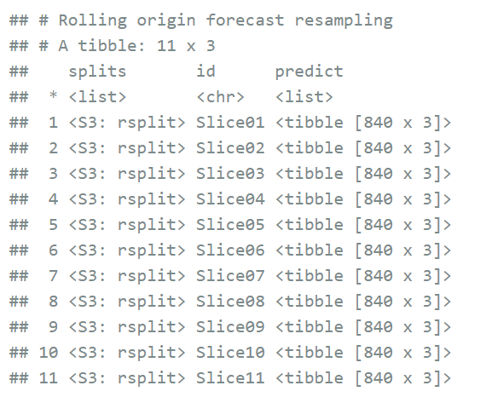
Keras LSTM Results
map(): custom keras prediction function

Slide 54
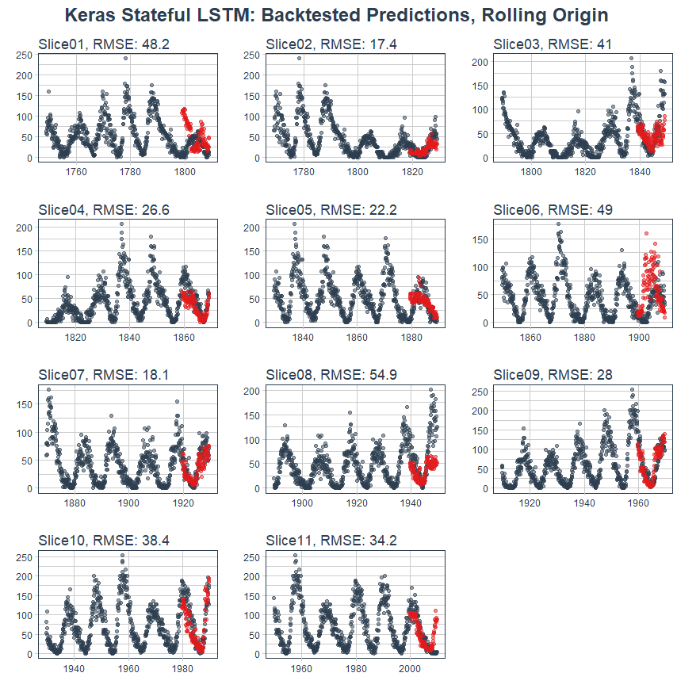
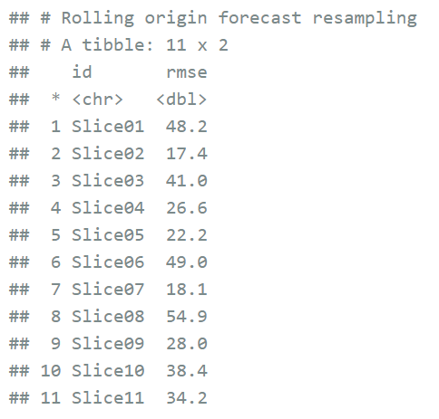
Keras LSTM Results

Slide 55
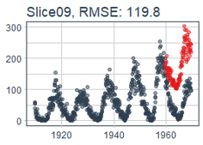
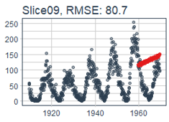
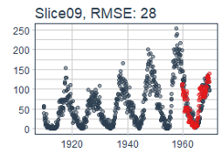
Technique Comparison
 | ARIMA | Prophet | Keras LSTM
RMSE (Average) Typical Model (Slice09) | 50.5 | 45.3 | 34.4
Keras Stateful LSTM: 32% Lower RMSE

Slide 56
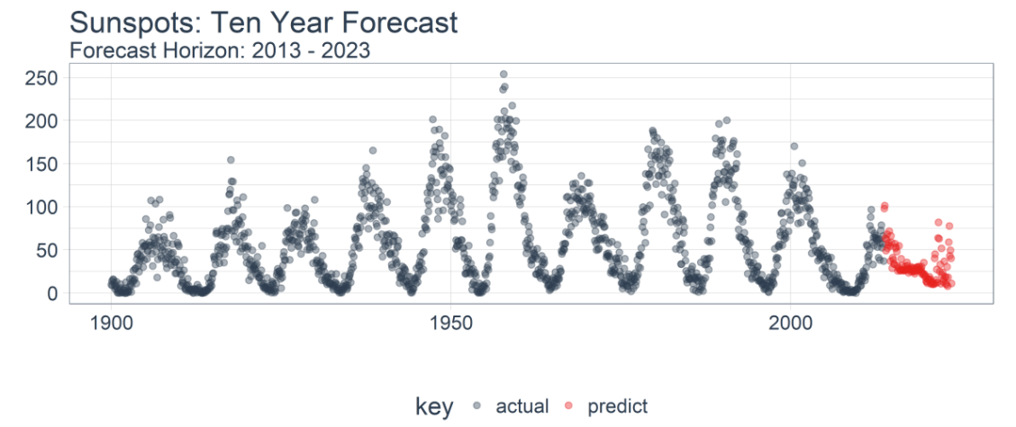
Forecasting Next 10 Years

Slide 57
Conclusions
Built a univariate Stateful LSTM with Keras
Benchmarked by Backtesting
High accuracy compared to other time series models
Good Tool-Application Fit

Slide 58
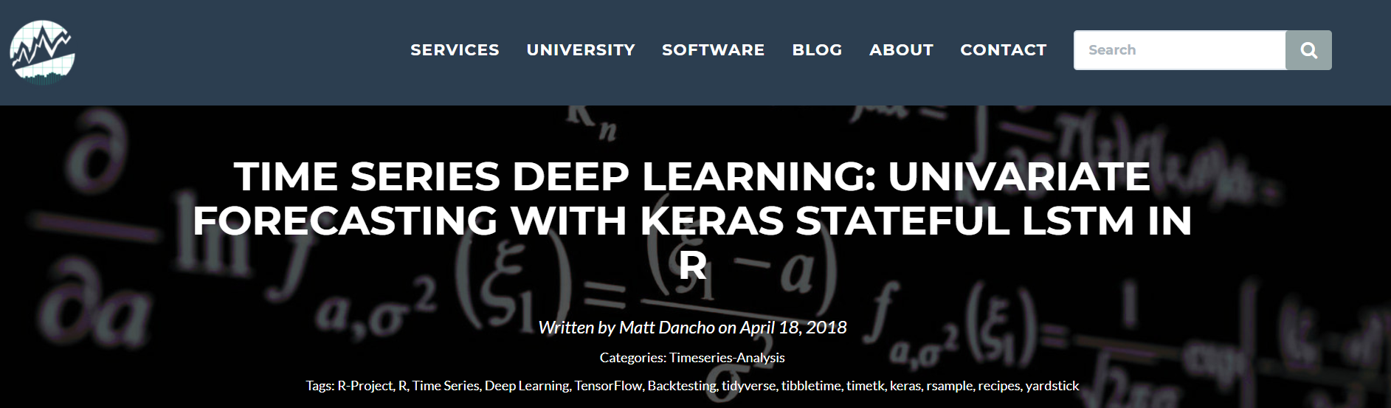
Code Available
Business Science Blog
Presentation linked in blog

Slide 59
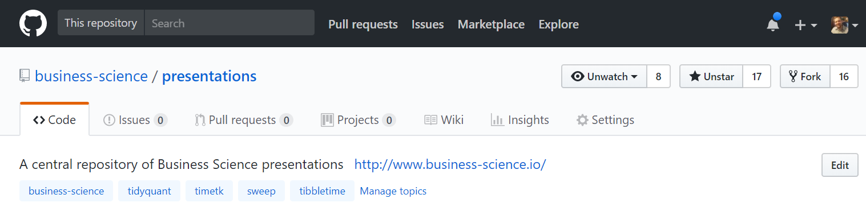
Presentation Available
Business Science GitHub
https://github.com/business-science/presentations

Slide 60

Business
+
Data
Science
business-science.io

